Slide 1
Restaurant Booking Analysis
Presenter Name : Karthi M
Guided By : Prof. Ankita Pai Nayak

Slide 2
Problem Statement
What are the most popular times of the year, months, weeks for booking hotels and its Cancellations?

Slide 3
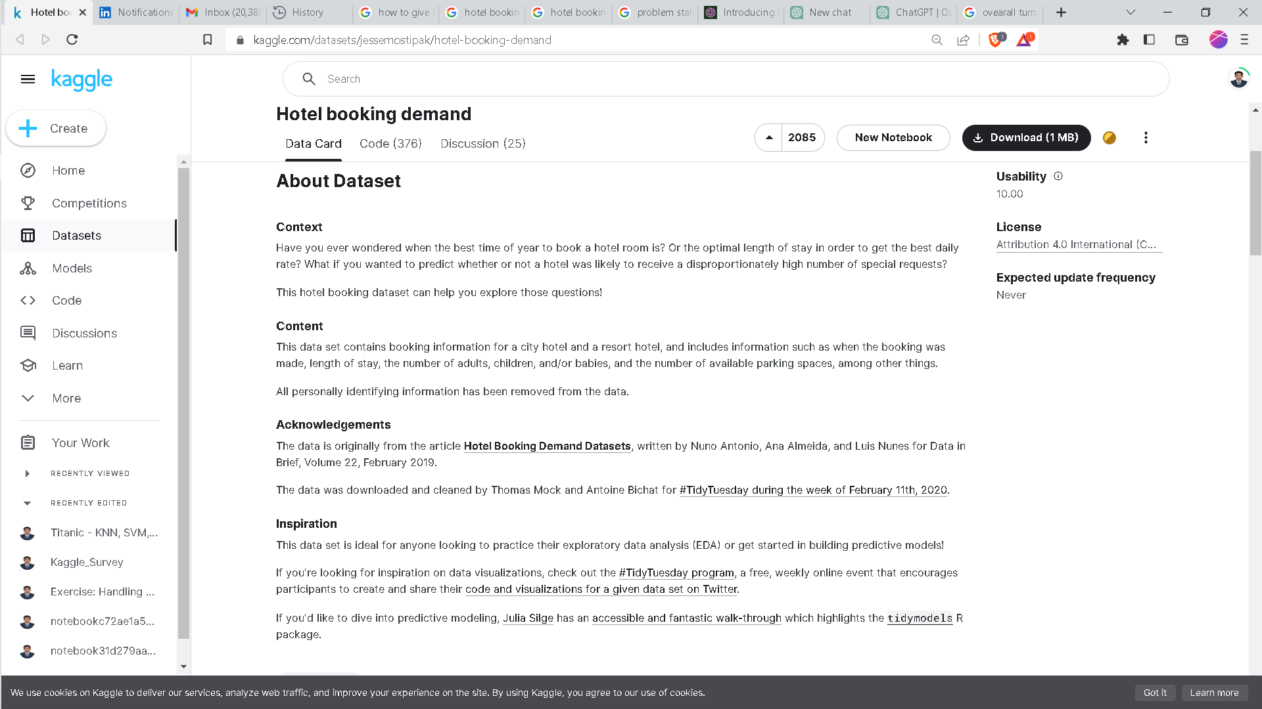
Meta Data

Slide 4
Meta Data Contd…
Source : Kaggle(https://www.kaggle.com/datasets/jessemostipak/hotel-booking-demand)
Size:119391 x 32

Slide 5
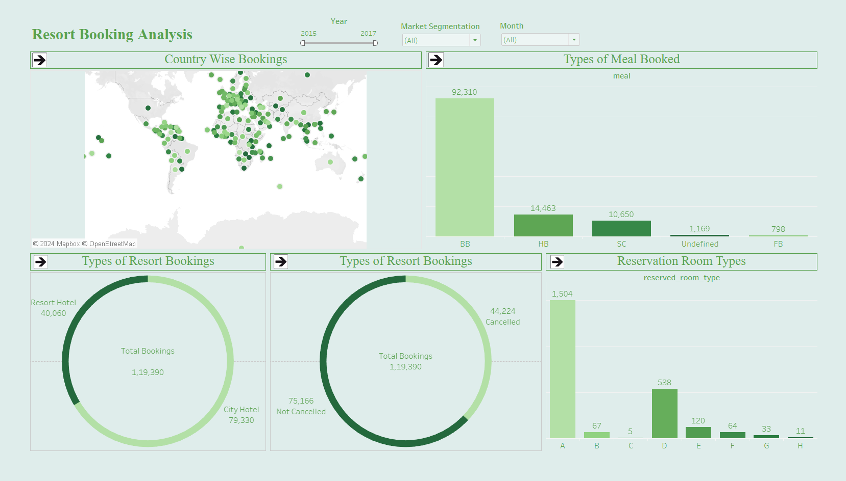
Dashboard

Slide 6
Conclusion
Restaurant booking analysis provides insights into peak hours and popular menu items, enabling establishments to optimize staffing and inventory management for improved operational efficiency.
By leveraging data-driven approaches, restaurants can enhance customer satisfaction by offering personalized experiences, optimizing table turnover, and anticipating demand fluctuations to meet customer needs effectively.

